Slide 1
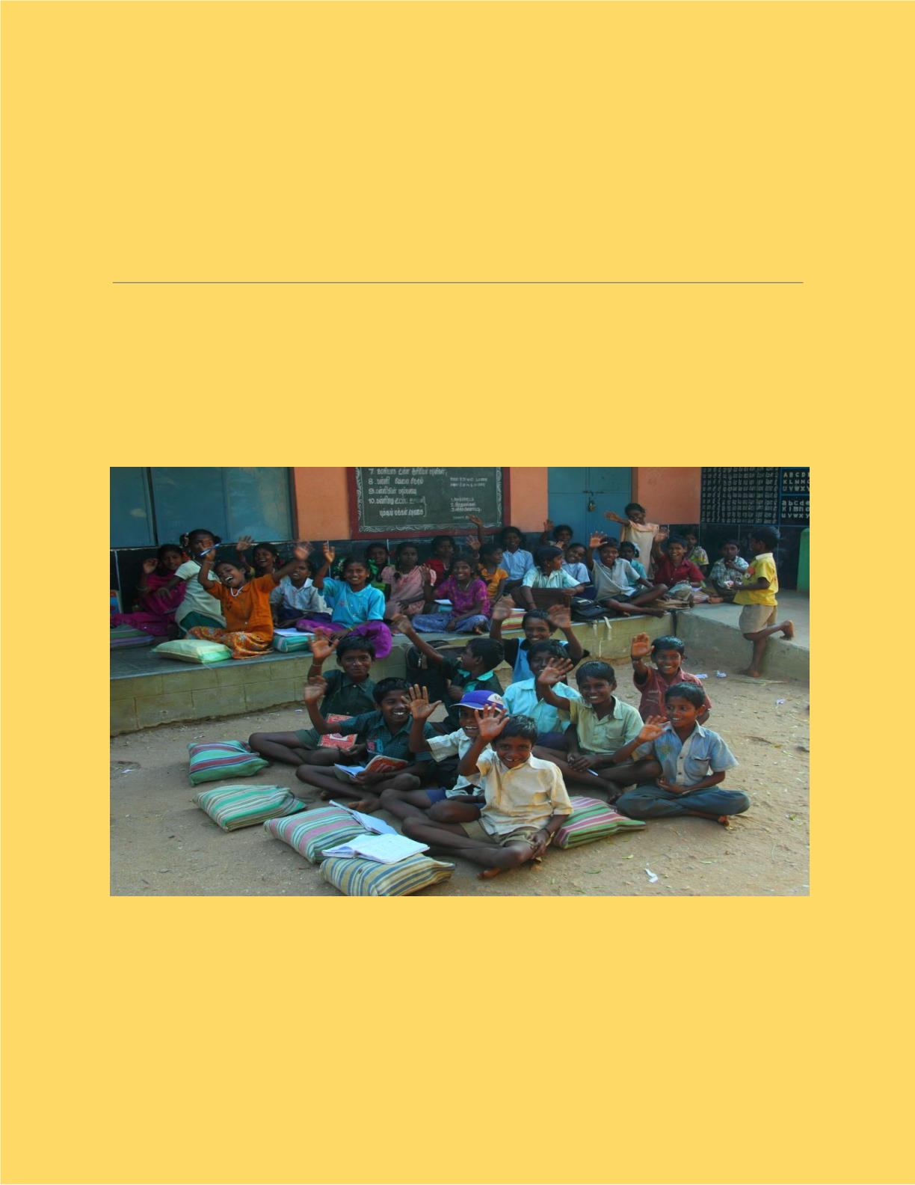
WEB APPLICATIONꢀ
DEVELOPMENTꢀ
TITLE: Walk with a Book
1

Slide 2

❏ Project Motivation:
The main motivation of the project is to
help the poor by giving books for
free.The primary focus will be to help
the poor,but it will also be helpful to
other people as well.
❏ Problem Statement:
In these present situations, it is difficult
for poor people to even afford
food,thus affording money for buying
books has become a big burden for
their child's education!!
❏ Problem Solution:
This website will play a major role in
giving books to the poor for free which
will be very helpful for them.
2

Slide 3

❏ Functional Description:
Total Modules : 8
❖ Module 1-Blueprint: We will first
create a blueprint of our website on a
paper.
❖ Module 2-Web Design: We will start
designing our website using HTML,
CSS and JS and Python for Home
page (front end).
❖ Module 3-Prototype: We will design
a login pop up window and after
logging in, the user will find options in
the page (Donate books/Buy
books/Hall of fame).
❖ Module 4-Client Needs: On
choosing :
3

Slide 4

➔ “Buy books” will redirect to a
page where there will be a book
shelf along with a filter and a
search bar. So, the user can select
the desired books and add them to
the cart.
➔ “Donate books” will redirect to a
page where the donors should fill
up the details like the name and
address.
➔ “Hall of Fame” will redirect to a
page where top donors are listed in
leader-board with the number of
books donated and can search
donors by their donation ID.
4

Slide 5

❖ Module 5-Database management:
By using MongoDB,we will connect to
the database and maintain user
records.
❖ Module 6-Tracking: In this module,
we will have a payment gateway and
order tracking.
❖ Module 7-Testing: We will test our
website for 2-3 weeks before
deploying.
❖ Module 8-Deployment: This is the
last stage, where we will deploy and
maintain the website with
improvements and no bugs.
5

Slide 6

❏ Project Overall Idea: People who
want to donate their books can login to
this website and can fill in the details
of the book like name,genre and
condition of the book. If the book is in
good condition to read,then he has to
give his address and then a pick up
guy comes to receive it. Donors get
the points or coupons which will be
helpful to buy books from a website
with low cost!! The book will be posted
on the website with title, edition,
proper photo and grade of the book.
Customers who are interested in that
book can place an order with only
delivery charges and order will be
received as soon as possible and
customers can keep track of order and
6

Slide 7

can contact customer care for any
further queries and updates.
❏ Group No: 30
❏ Group Leader:
Anirudh Jakhotia
❏ Group members:
● Neeraj Dusa
● Harish Mullagura
● Rakesh Ganeshula
● Jayanth Sri Ram Kanduri
❏ Duration: 6-7 hours per week
7

Slide 8
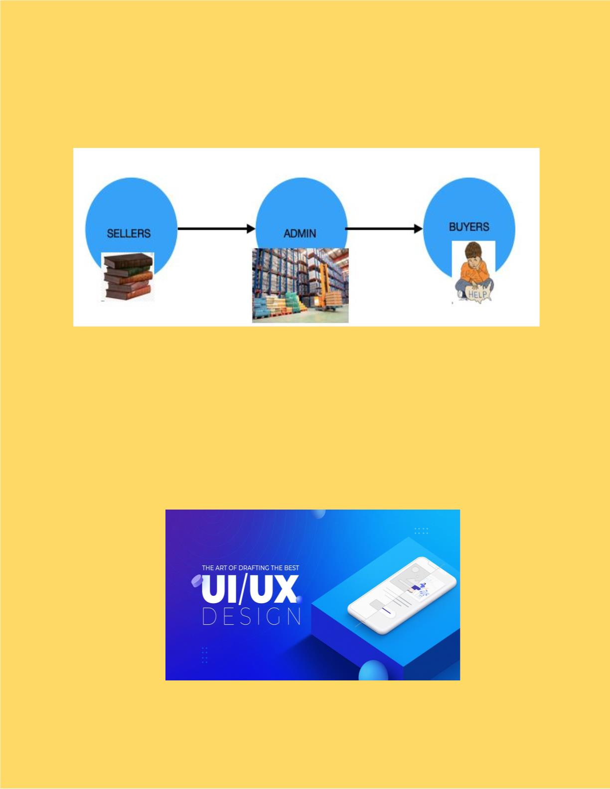
Primary Blueprint Of Our Idea
FEATURES
● Better UI / UXꢀ
8

Slide 9
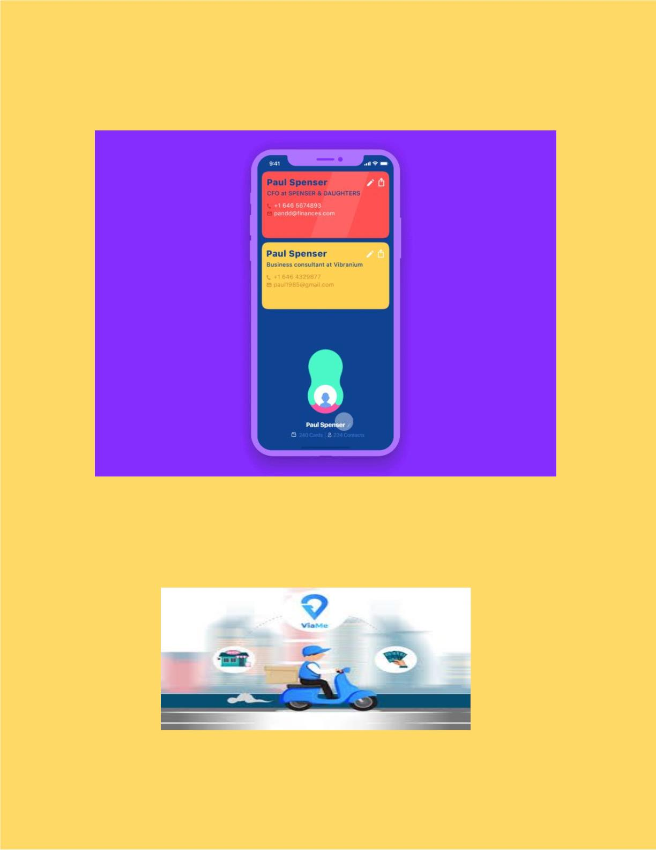
● Easy Usageꢀ
● Cash on Deliveryꢀ
ꢀ
9

Slide 10
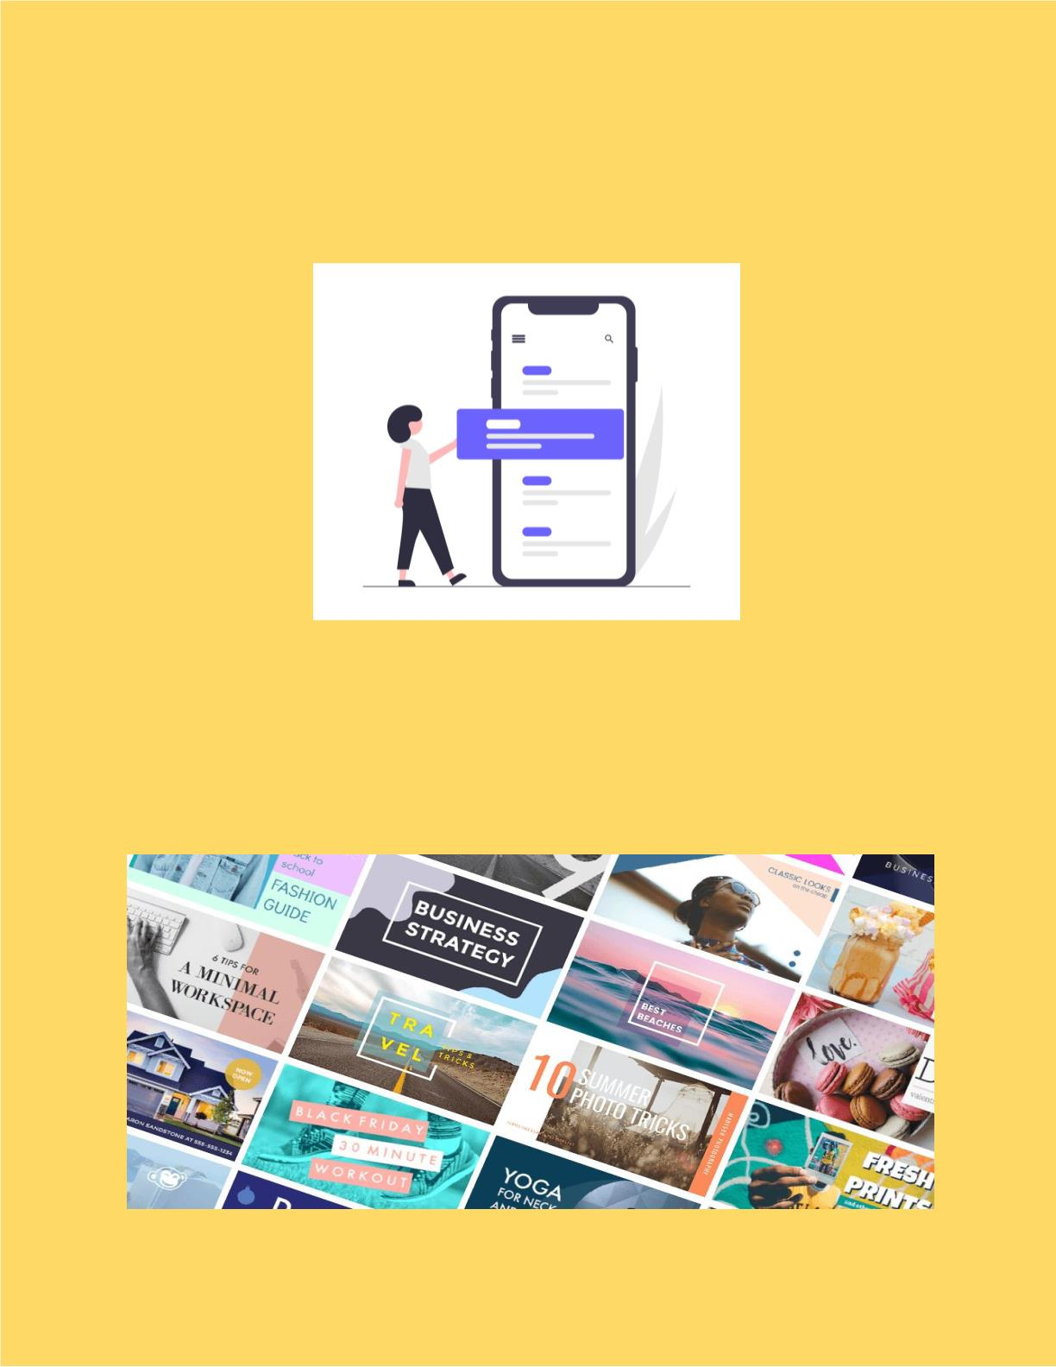
● Clean navigational menu with an In-Siteꢀ
Search and product categories.ꢀ
● Good quality product photos with imageꢀ
zoom and thumbnailsꢀ
ꢀ
10

Slide 11
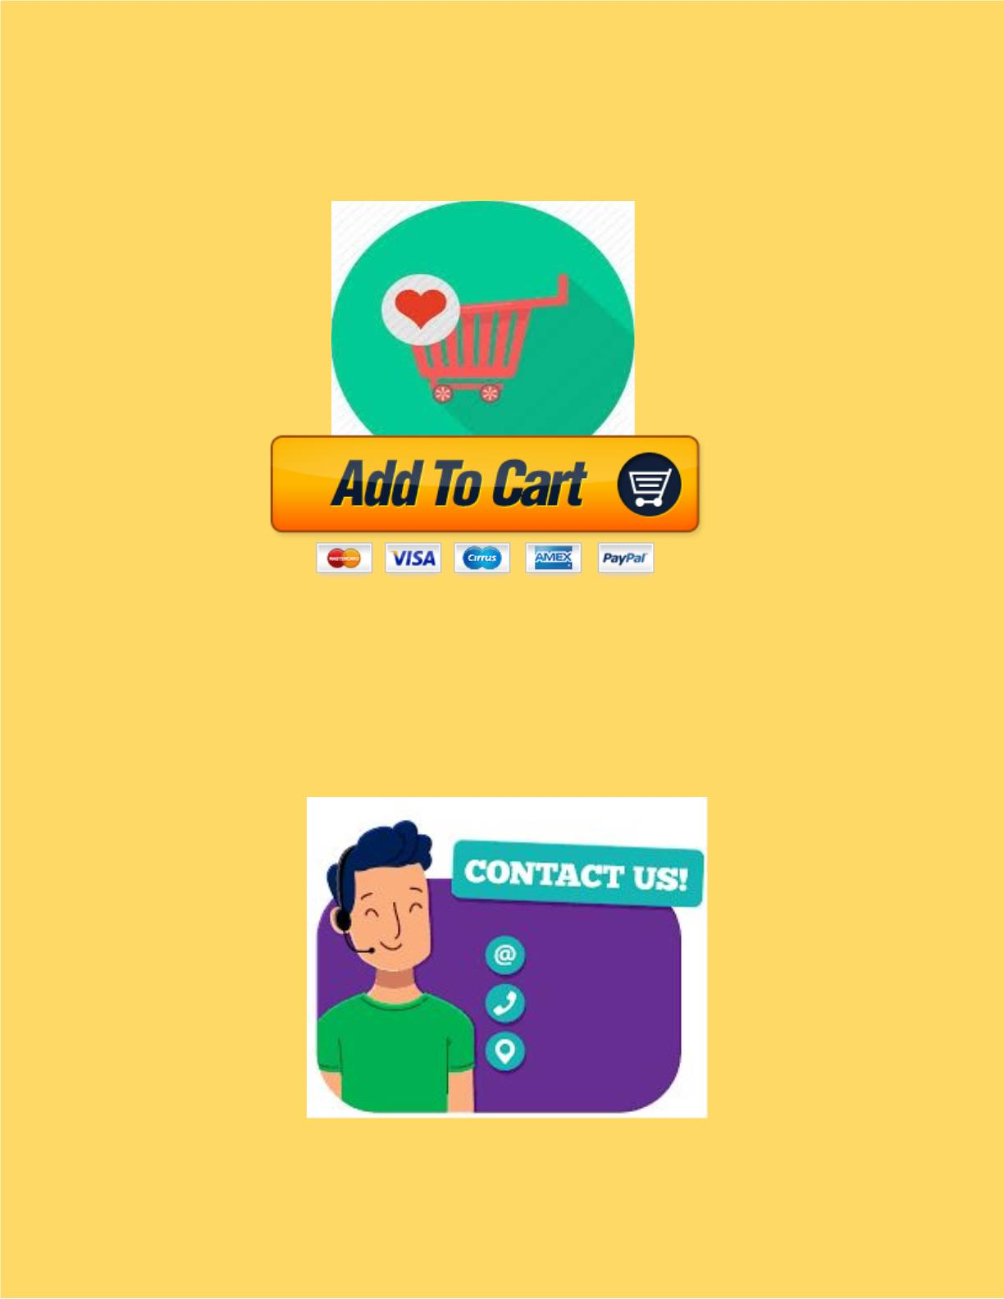
● Wish-list and Add to cartꢀ
ꢀ
● Engaging and informative “About Us” pageꢀ
with contact details.ꢀ
11

Slide 12

● Social media connectionsꢀꢀ
ꢀ
ꢀ
ꢀ
● Suggestions and user feedback is takenꢀ
ꢀ
ꢀ
ꢀ
ꢀ
12

Slide 13
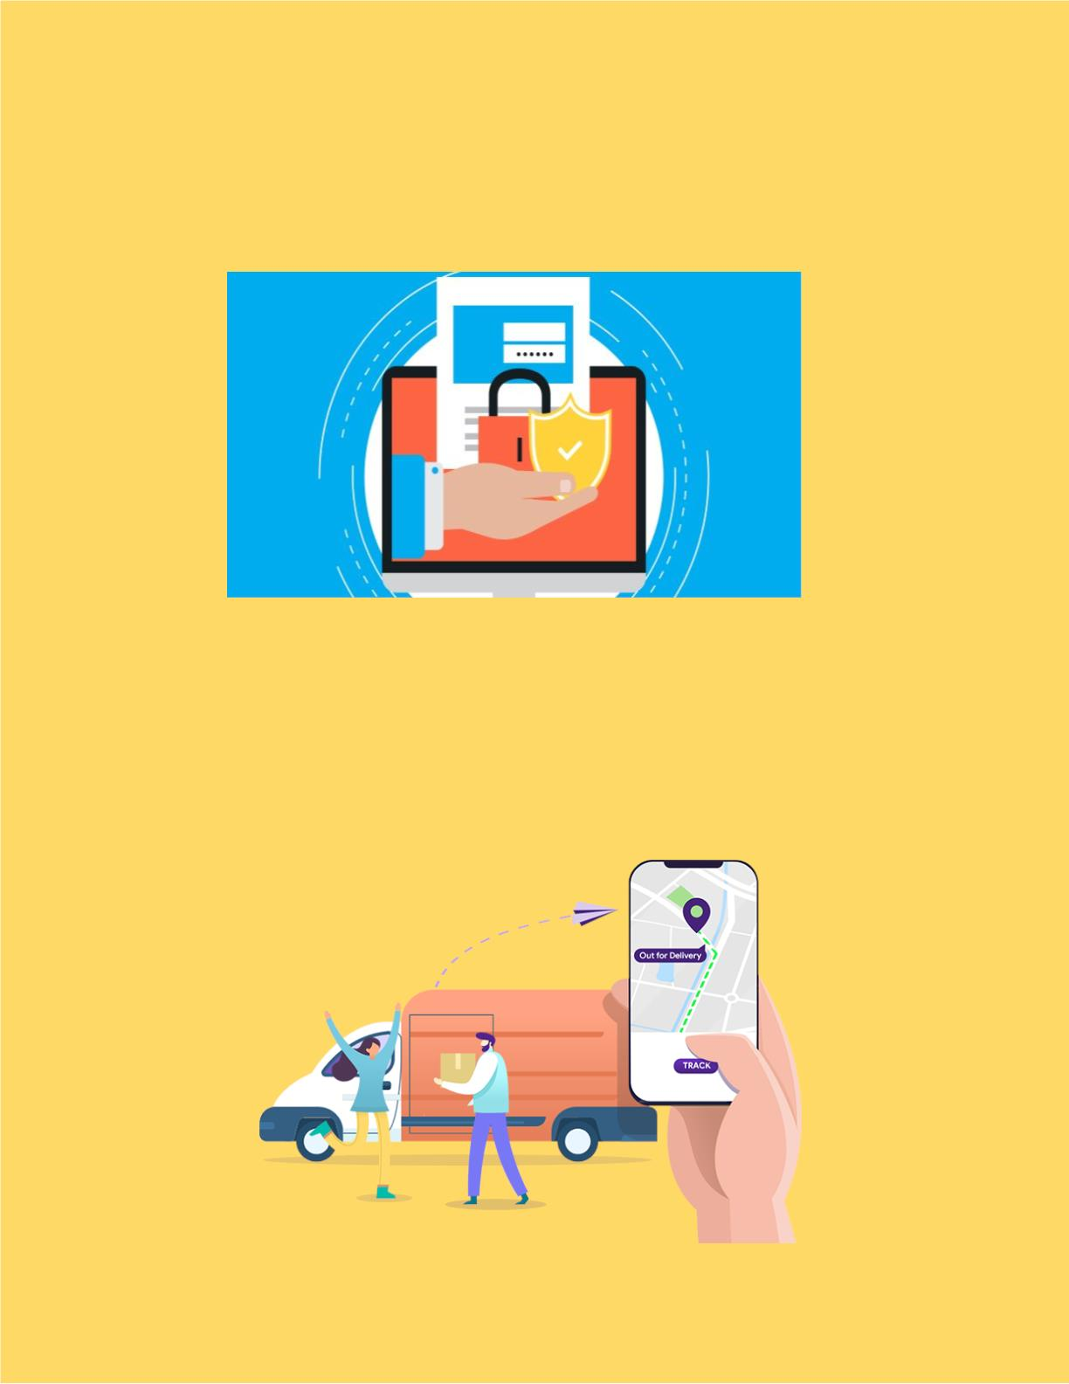
● Secure Login and User information isꢀ
safeꢀ
Further Updates :ꢀ
● Tracking option for orders.ꢀ
ꢀ
13

Slide 14
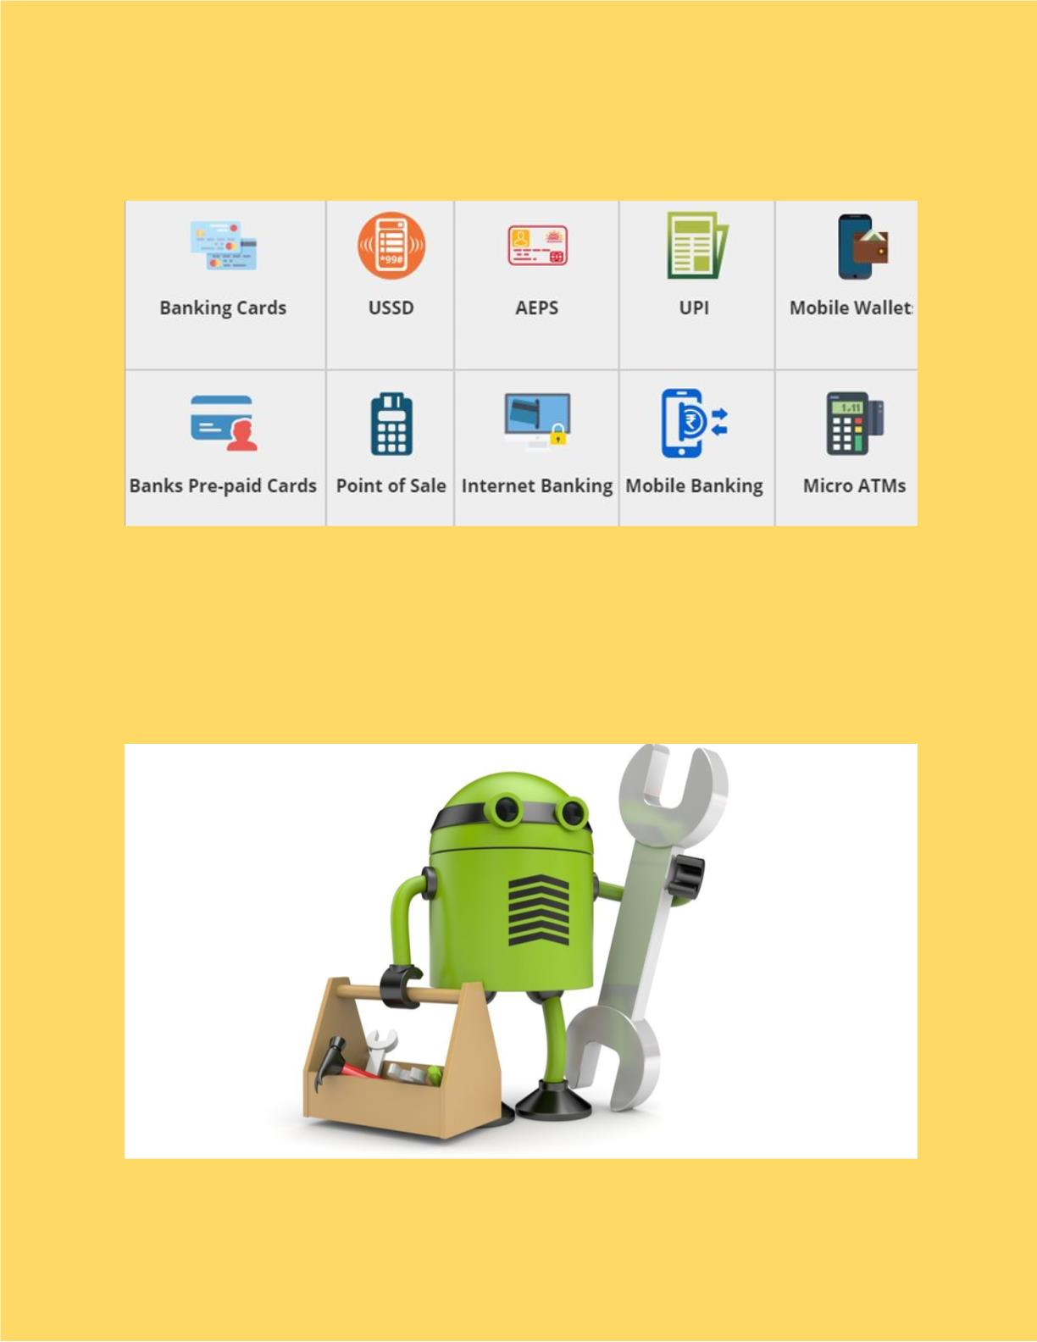
● E-Paymentꢀ
ꢀ
ꢀ
● Bug fixes and performance improvementsꢀ
ꢀ
ꢀ
14

Slide 15
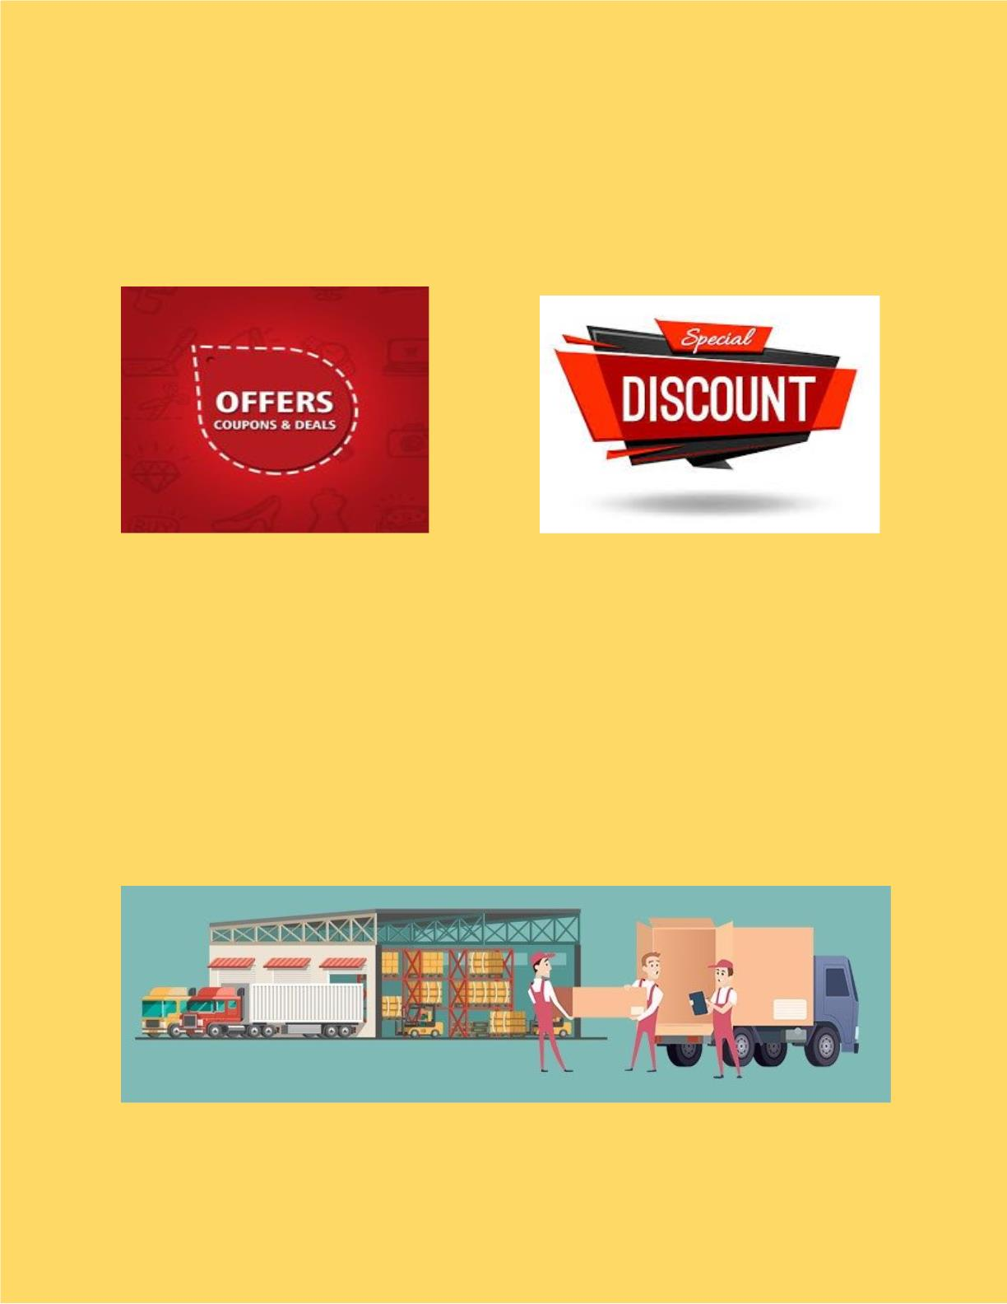
ꢀ
ꢀ
● Discount offers and coupons for Donorsꢀꢀ
ꢀ
ꢀ
ꢀ
● Will soon provide other products alongꢀ
with booksꢀ
ꢀ
ꢀ
ꢀ
ꢀ
15

Slide 16

Connectivity
● Hall of fame :ꢀ
ꢀ
The top 15 donors are posted in theꢀ
Hall of Fame with their Name,photoꢀ
and Contact information.ꢀ
ꢀ
16

Slide 17

● Delivery can be reached for variousꢀ
possible places of India
● Sending email to Othersꢀ
Can send a direct email for others toꢀ
check about the website and canꢀ
suggest a book and can interact withꢀ
the Donors.
17

Slide 18
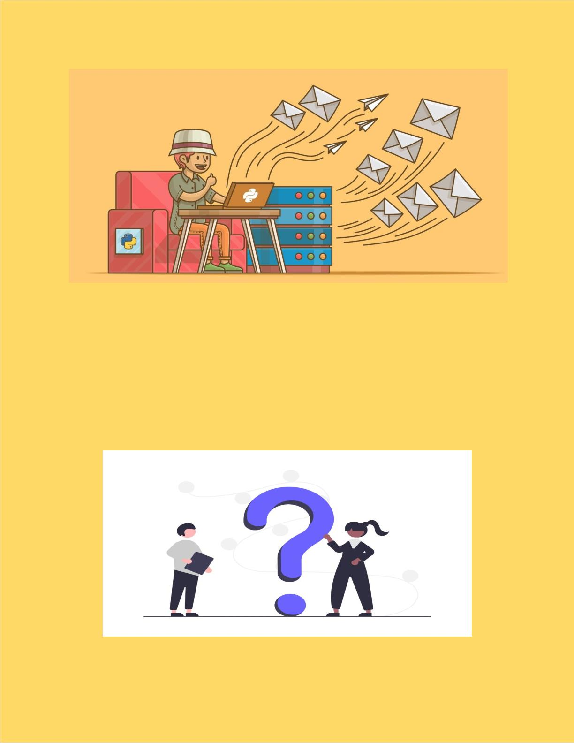
ꢀ
● QNA Queriesꢀ
For any queries about the books andꢀ
other details can ask questions andꢀ
will be replied soonꢀ
ꢀ
18

Slide 19
Work Assigned
Anirudh Jakhotia : Graphic Designer
and Securityꢀ
Neeraj Dusa : Information Gathering and
Catalogue managementꢀ
Harish Mullagura : Database managementꢀ
and Trackingꢀ
Rakesh Ganeshula : Website Developerꢀ
and payment gateway
Jayanth Sri Ram Kanduri : UI/UX
Designer, Manages bug fixes and improvement.
19

Slide 20

Software Components :ꢀ
➢ HTML,CSS,JS,Python,Django,Bootstrap,ꢀ
MongoDB Editor - VS Codeꢀ
➢ Web Browser - Google Chromeꢀ
➢ Graphics Editor - GIMP,Adobe Photoshopꢀ
➢ FTP Client - Filezillaꢀ
➢ New Software components to be added forꢀ
further development.ꢀ
Preliminary work :
20

